Slide 1
Session 2 - Hadoop Configurations

Slide 2
Pre - requisites
Complete Unit 2.0
Faculty Video Lecture
Self Assessment Quiz Complete
Cloudera Virtual Machine Installed
Basic Linux Commands Practiced

Slide 3
Session Content (Hadoop Configuration)
Queries on Unit 1
Block Versus Splits
Session 1 leftovers
Hadoop Machine Configuration Requirements
Hadoop Installation Modes
Important Configuration Files
Running first Hadoop example
Checking other examples in the CDH

Slide 4

Queries on Unit 1.0

Slide 5
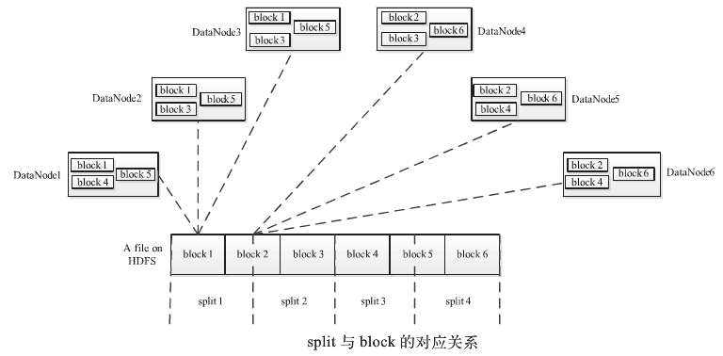
Block Versus Split
Block is a physical Division of data (Data at Write Time)
Split is a logical division of data (Data at Read Time)

Slide 6
Session 1 Leftover
Hadoop Architecture - Map Reduce Process Flow
Data Visualization – R & RStudio

Slide 7
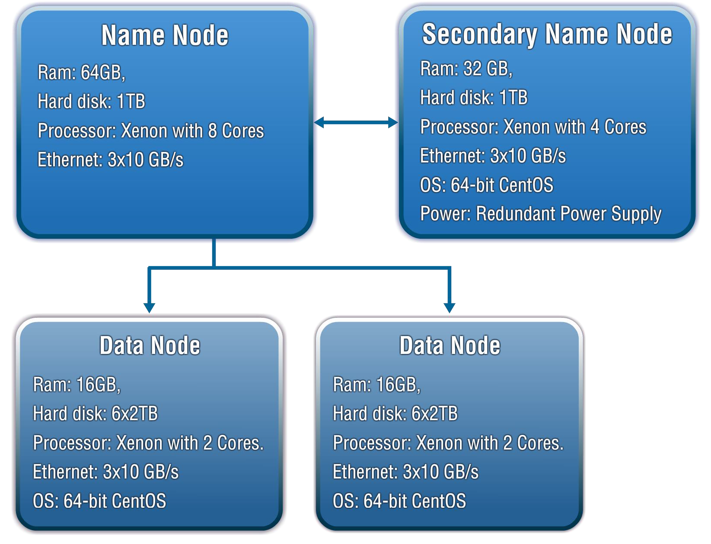
Hadoop Machine Configuration

Slide 8
Hadoop Installation Modes
Stand Alone (or local) Mode
There are no daemons running in this mode
It is usually used for initial installation testing or development purpose
Pseudo-Distributed Mode
Here the daemons run in separate process but on the same machine.
Used for production like simulation testing (call it SIT or UAT) before moving to production
Fully Distributed Mode
Actual production environment comes into picture with Admin node and commodity machines in the cluster
Used for production environments

Slide 9
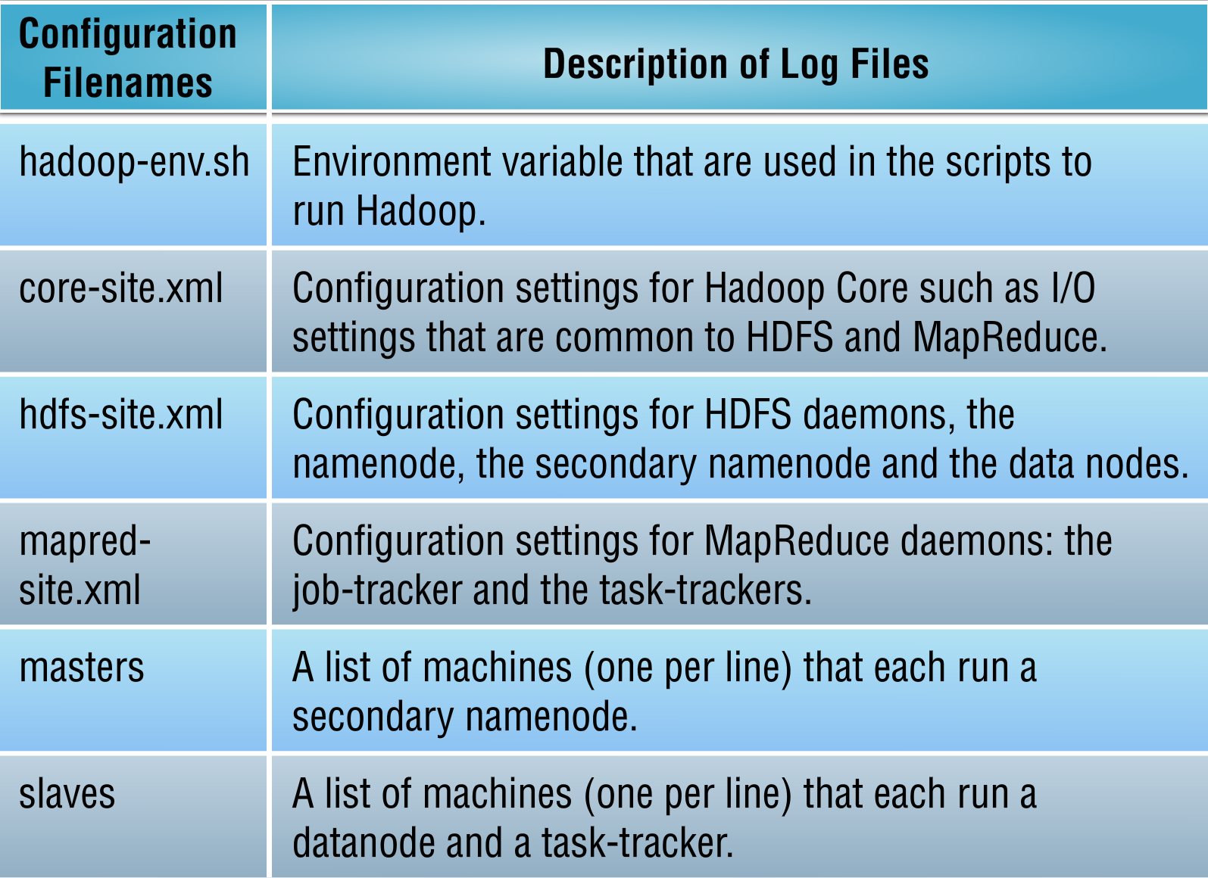
Hadoop Configuration Files

Slide 10
Hadoop Configuration Properties URL
http://hadoop.apache.org/docs/r1.1.2/hdfs-default.html
http://hadoop.apache.org/docs/r1.1.2/mapred-default.html
http://hadoop.apache.org/docs/r1.1.2/core-default.html

Slide 11
Queries on Unit

